Slide 1
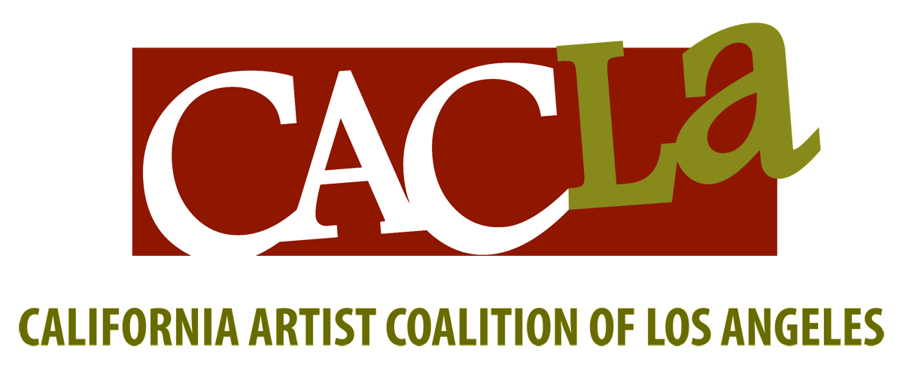
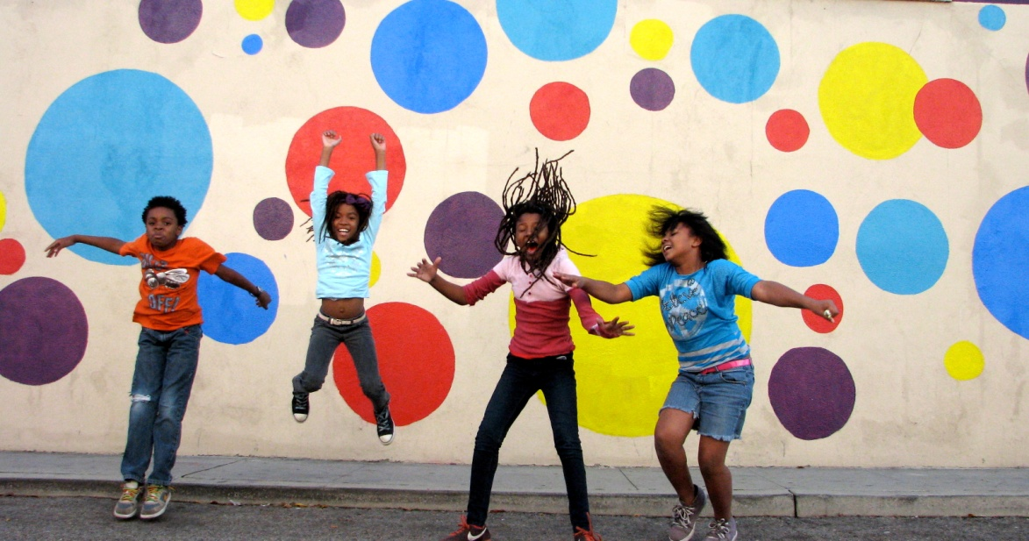
Empowering Youth Through Public Art and Beautification Projects

Slide 2
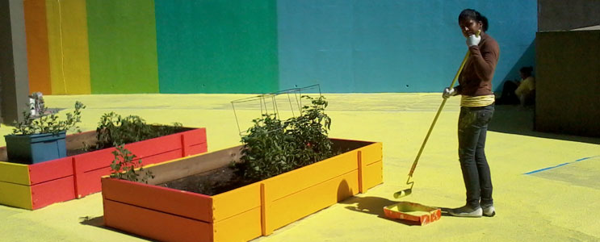
Get Youth Invested In Their Community
Through the affordable medium of paint and collaborations that engage students and the community as a whole

Slide 3
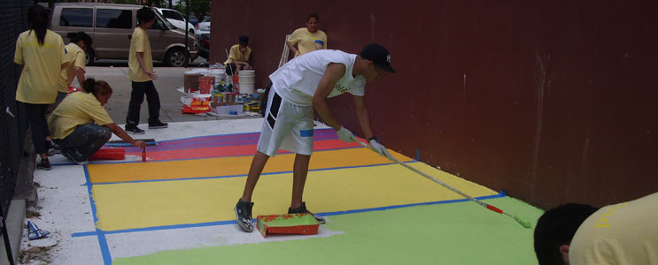
A students transform their communities,
they begin to transform themselves….

Slide 4
Elementary and Middle school students are provided goal-directed involvement that instills a sense of ownership and pride in where they live.
We connect professional artists with each project to beautify and revitalize public and civic spaces.
Our projects highlight the techniques of famous artists such as Damien Hirst, Paul Klee, Mondrian and Jean-Michel Basquiat, to name a few, offering visual art discussions through a solution based approach.

Slide 5
Founded in 2006, our Mission is to provide creative and innovative solutions to bring public art and beautification projects to under served communities.
A 501(c)(3) non-profit artist based organization.
We provide Artists and Staff to work directly with students, we provide Project Design and we provide all Supplies & Materials needed for each project.
We successfully executed a three-year contract with the Community Redevelopment Agency of Los Angeles (CRA) to create, facilitate and manage public art projects in enterprise zones.
We’ve collaborated with other Arts Organizations, City and County Agencies because of our unique experience and expertise in executing public art projects from creation to completion.

Slide 6
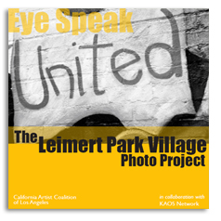


And we’ve had fun!

Slide 7
Bring a CACLA Project
to your school/community space
www.cacla2006.org
Copyright CACLA @

